Slide 1
Analysis of COVID-19 Tweets Using EID3 Decision Tree Algorithm in Spark Environment

Slide 2
Index
Introduction
Problem statement
Objectives
Literature Survey
Existing System
Proposed System
Implementation
Conclusion
References

Slide 3
INTRODUCTION
With the ever-spreading of online purchasing websites, micro-blogging sites, and social media platforms we have taken the advantage by using the reviews, tweets and blogs acquired from these social media networks, which act as a significant source for enhancing the decision making process using big data.
The obtained textual data (reviews, tweets or blogs) are classified into 3 different class labels which are negative, neutral and positive for analysing and extracting relevant information from the given dataset using a new algorithm ‘EID3’.
Firstly we have used several feature extractors to efficiently detect and capture the relevant data from the given tweets, after this we have applied a multiple feature selector to reduce the high feature’s dimensionality, finally we have employed the obtained features to carry out the classification task using our ‘EID3’ algorithm. This work is implemented in a Spark environment using the python programming language.
Big data is a collection of massive and complex data sets and data volume that include the huge quantities of data, data management capabilities, social media analytics and real-time data. Big data analytics is the process of examining large amounts of data.
A classification algorithm is a function that weighs the input features so that the output separates one class into positive values and the other into negative values. The basic idea of ID3 algorithm is to construct the decision tree by employing a top-down, greedy search through the given sets to test each attribute at every tree node. We analyse the covid-19 tweets using EID3 algorithm to create awareness so that measures and precautions are taken to avoid covid-19 using datasets in spark.

Slide 4
PROBLEM STATEMENT
Due to increasing deaths and infection because of corona virus, tweets have been flourishing in social media we use an algorithm to classify covid-19 tweets based on their polarity (negative or positive) and then to eliminate negative tweets and extract information from positive tweets. These tweets are used create awareness, measures and precaution to prevent covid-19. This is done using big datasets with help of a spark.

Slide 5
OBJECTIVES
To extract relevant data from the tweet by performing feature extraction.
To enhance the performance of a well –known algorithm classifier in terms of accuracy, execution time and ability to handle the massive datasets.
To integrate the weighted theory and information gain criteria using our novel algorithm.

Slide 6
LITERATURE SURVEY
Sl No | Author | Paper Title | Technique | Advantages | Disadvantages
1 | Es-Sabery | A Map-reduce opinion mining for covid-19 related tweets classification using ID3 decision tree classifier | ID3 algorithm, N-gram, Bag-of-words, Glo-Ve, Word2Vec, Fast-Text and TF-IDF | The improved algorithm considers the association between the immediate conditional feature, decision feature, and the other conditional features to compute the weighted information gain, then find the best split feature. | Cannot use traditional ID3 as it considers only the association between the current feature and decision feature to calculate the information gain.
2 | Sandeep Kumar | Analysis and Predictions of Spread, Recovery, and Death Caused by COVID-19 in India | Correlation coefficients and multiple linear regression, autocorrelation and auto-regression. | It is observed that the model can use regression against itself and also able to use the autocorrelation plot to check the randomness within the data and to improve the accuracy of prediction. | Decision tree learning technique is equally useful for regression and classification. This approach assigns the most feasible class for each record for classification.
3 | Vishan Kumar Gupta | Prediction of covid-19 confirmed, death, cured in India using Random Forest Model | Random forest, linear model, multi class classification, support vector machine, decision tree, neural network and K-fold cross-validation | It is found that the random forest method outperforms other machine learning methods. K-fold cross validation is used to measure the consistency of random forest model. | 30% data are tested using these all five models, the results from all the five models are collected and found that the random forest model outperformed. Machine learning methods do not embody any additional information from different Models.

Slide 7
Sl No | Author | Paper Title | Technique | Advantages | Disadvantages
4 | Nugroho Setio Wibowo | Twitter Data Analysis Using Machine Learning To Evaluate Community Compliance in Preventing the Spread of Covid-19 | Logistic regression and random forest, TF-IDF, decision tree | The Logistic Regression and Random Forest algorithms have better accuracy of 93% compared to the Decision Tree of 89% and are used as a model for assembling between Logistic Regression and Random Forest | No mention
5 | Prasoon Gupta | Sentiment Analysis of Lockdown in India During COVID-19: A Case Study on Twitter | Linear SVC classifier and unigram | The combination gives us an accuracy of 84.4% consolidated the performance by calculating precision, recall, F1-Score, and tenfold cross-validation for all the combinations, and we got the best results with Linear SVC and unigram | The major limitations of this work are that we have taken the tweets of a specific phase during the lockdown, but with the change of phases, the surrounding conditions might get changed thus, the sentiments of the public could also be changed.
6 | Habiba Drias | Mining Twitter Data on COVID-19 for Sentiment analysis and frequent patterns Discovery | FP-Growth algorithm, lexicon-based approach | The construction of the FP-tree considers only the f-list words and is consequently a data structure reduced to only relevant information. It starts with an empty node, then it creates nodes taken sequentially from the f-list and linking them if they belong to the same tweet while scanning the collection of tweets and incrementing their frequency | No Mention

Slide 8
Existing system
This work is implemented in Spark environment using python language.
Its primary goal is to enhance the performance of a well-known ID3.

Slide 9
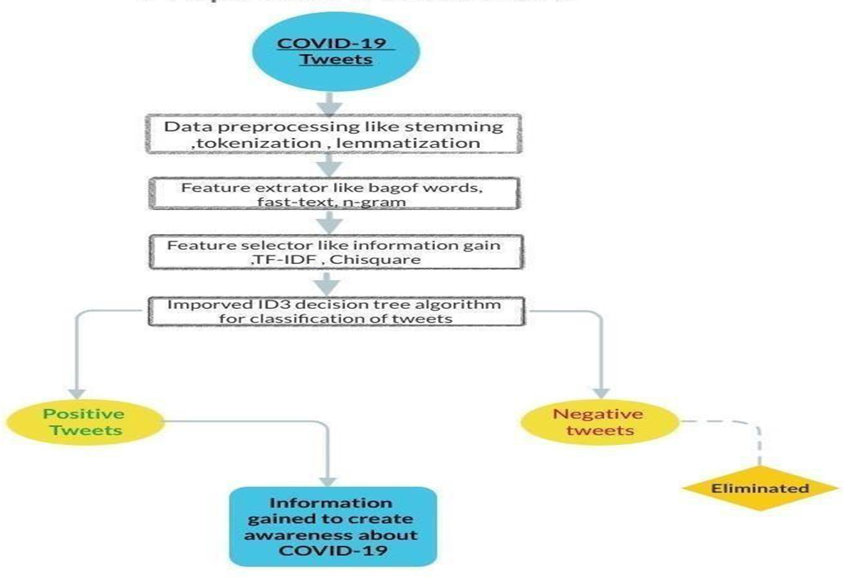
SYSTEM DESIGN

Slide 10
SYSTEM DESIGN
Data preprocessing - Normalize semantic data , eliminate unwanted information and clarify vocabulary employed to analyze emotions from tweets.
Feature Extraction – Turns text based input data into set of numerical features. The effectiveness of classifier depends on it (example : N-Grams , Bag of Words )
Feature selection – Eliminates irrelevant features
The proposed model uses EID3 algorithm to classify Covid-19 tweets into positive & negative polarity and then the positive tweets are used to get information to create awareness about the spread of Covid-19.

Slide 11
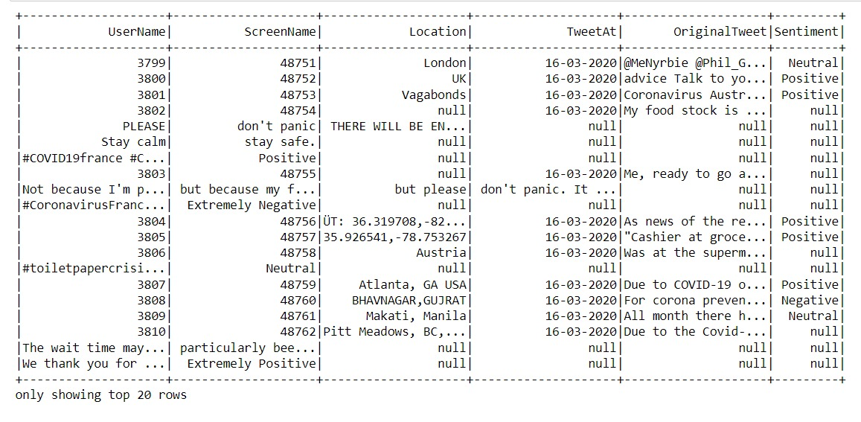
IMPLEMENTATION IMPORT DATASETS
The total number of tweets in this dataset are 68045. The datasets is collected from GitHub website.
Screenshot 1

Slide 12
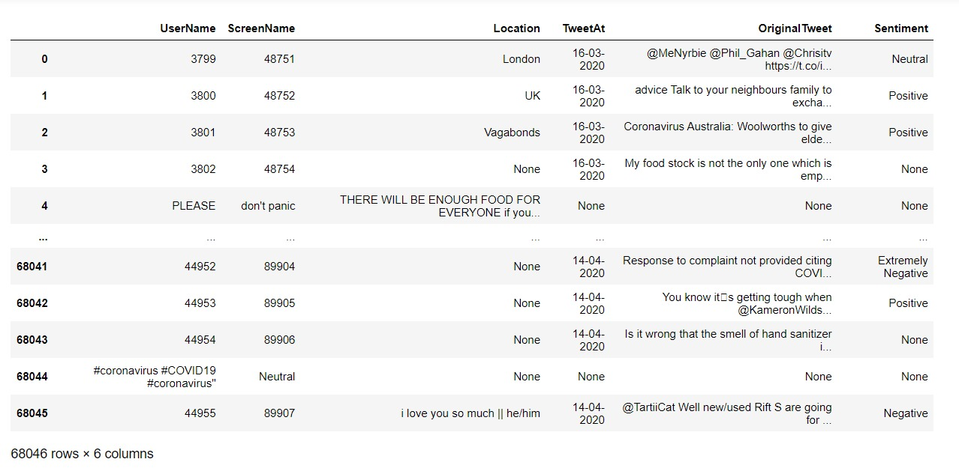
DATA ANALYSIS
Data analysis is a methodical application of statistical or logical tools for describing illustrating, condensing, summarizing and evaluating data. This dataset includes features like UserName, Location, TweetAt, Original Tweet and Sentiment.
Screenshot 2

Slide 13
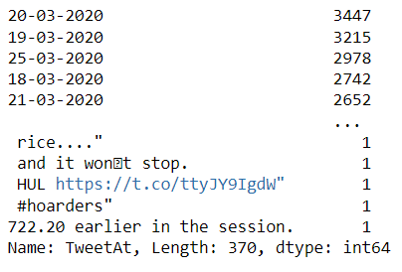
This screenshot shows the date and number of tweets posted on the particular date.
Screenshot 3

Slide 14
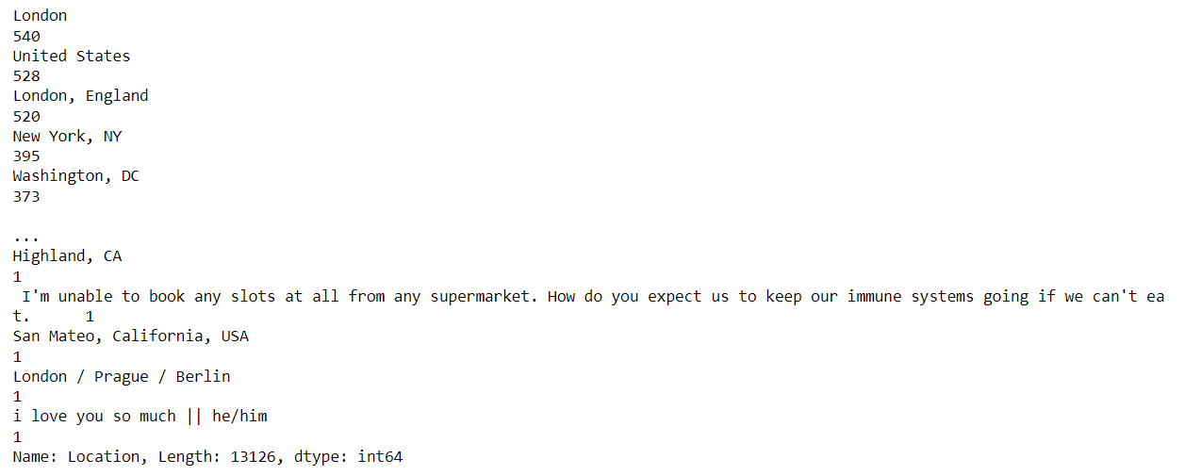
This screenshot shows the country and the number of tweets posted on the particular country.
Screenshot 4

Slide 15
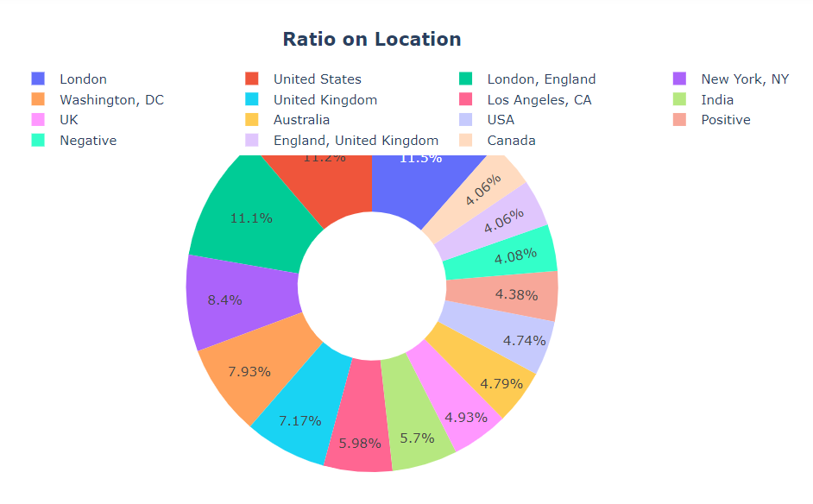
Screenshot 5

Slide 16
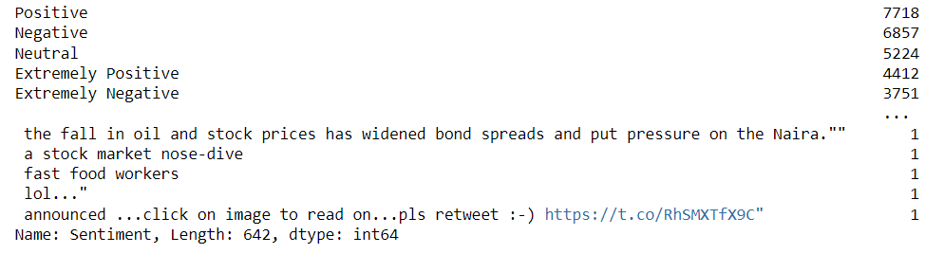
This screenshot shows the polarity of the tweets.
Screenshot 6

Slide 17
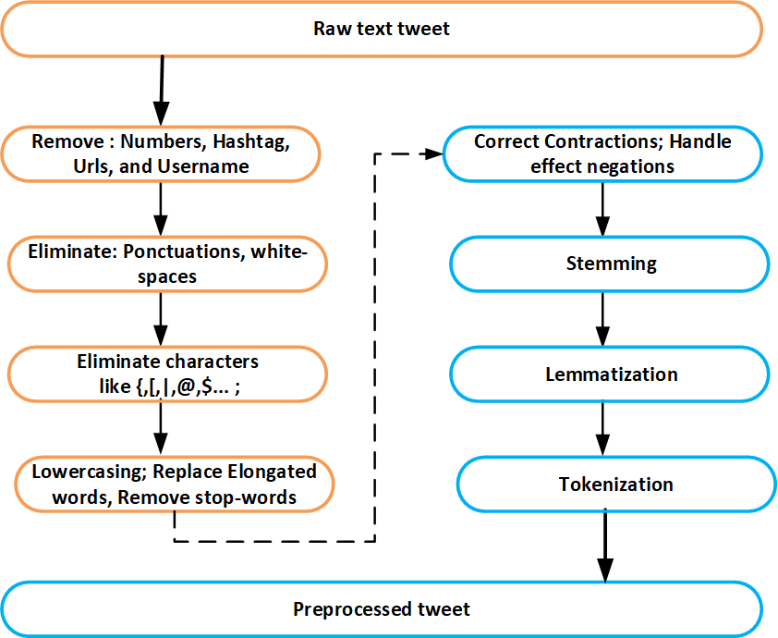
DATA PREPROCESSING
Fig. Data Preprocessing

Slide 18
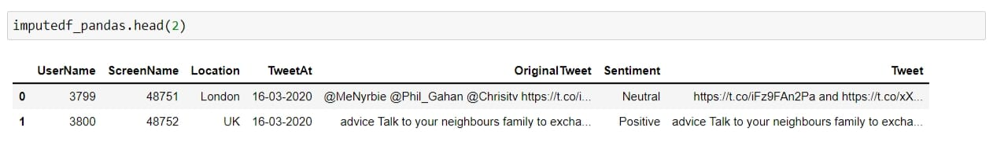
Remove usernames, numbers, hashtags, and urls
It is a common technique to remove the usernames, numbers, hashtags, and URLs from the tweet since they do not express any sentiments.
Screenshot 7

Slide 19
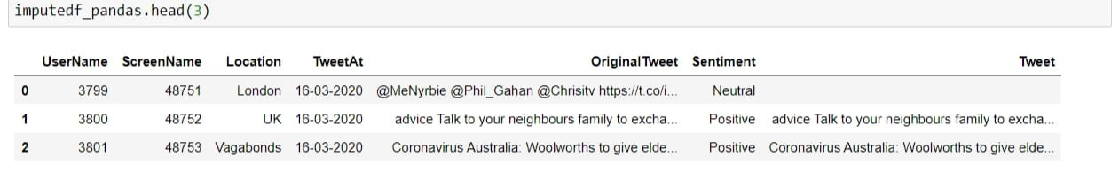
Remove white-spaces, punctuation, and special characters:
This stage is to perform is removing all occurred white-spaces in the tweet, then we delete exclamation, stop and question punctuation marks. Finally, as we know the special characters do not hold any negative or positive effect on communicated opinion in the given tweet, hence all existed special characters are eliminated
Screenshot 8

Slide 20
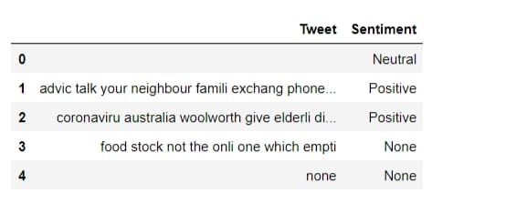
Lower-casing
All the uppercase letters in the given tweet were converted to lower case, and that minimize the dimensionality of each terms.
Stemming
This aims to reduce the size of each word by converting the derived word into its root, or stem form.
Screenshot 9

Slide 21
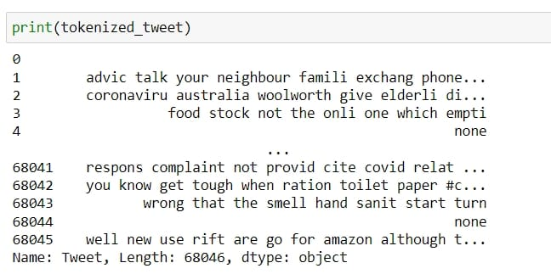
Tokenization
It is a technique that divides each input tweet into a set of meaningful words since each word is named a token
Screenshot 10

Slide 22
DATA REPRESENTATION
The primary purpose here is to summarize and convert text-based input data into a set of feature vectors that operate agreeably to the used machine learning classifier.
N-Grams :
The N-grams methods aid in forming useful word representation vector for unknown words, thus enhancing classification accuracy in tasks based on textual data, where a significant portion of unknown words appears, e.g., in opinion mining.
Bag of Words :
It is considered as a valuable and straightforward approach for data representation that maps a set of sentences to be classified into a numerical vector.
TF-IDF:
TF-IDF is used for data representation because it takes into account the frequency of a word over the whole list of documents, here every word is assigned a weight according to how pertinent it is to that sentence.

Slide 23
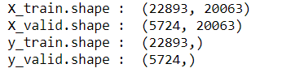

Test train split of the data
EID3 Decision Tree Algorithm:
The classification challenge comes next, when we apply enhanced ID3 to assign each input text to one of three class labels: negative, neutral, or positive. A classification paradigm known as the ID3 decision tree technique seeks to quantify the IG criterion for decision tree construction.
This algorithm shows the accuracy score of the training and testing data.
Screenshot 11

Slide 24
Conclusion
The main objective of this project is to spread awareness among people about ongoing COVID-19. This pandemic is causing a lot of drastic changes in every society. In order to cause rebellion against the disease causing to people and educating by means of preventive measures and sanitization of our belongings by using tweets made by the public in the platform known as Twitter.
Most of the methods and techniques employed are economically feasible and it's non-physical and completely virtual. In our project we have used tweets as the datasets from Twitter which leads to dealing with Big Data in order to classify and to distinguish the polarity of the opinion on the basis of Big Data techniques.
We have used an improvised, advanced, time and space efficient ID3 algorithm and the techniques used are feature extraction, stemming, lemmatization…..,etc. The whole process is done in the spark environment for better results.
When people are aware of the symptoms and the affection caused by the COVID-19 through our work we can prevent deaths and economic shrink in the society.
This project can be used to get information on many other things using datasets from tweets, other than diseases information on various products, stocks and many other things can be obtained.

Slide 25
REFERENCES
[1] Fatima Es-Sabery, Khadija Es-Sabery, Junaid Qadir “A MapReduce Opinion Mining for COVID-19-Related Tweets Classification Using Enhanced ID3 Decision Tree Classifier” DOI: 10.1109/ACCESS.2021.3073215
[2] Rajani Kumari, Sandeep Kumar “Analysis and Predictions of Spread, Recovery, and Death Caused by COVID-19 in India” DOI: 10.26599/BDMA.2020.9020013
[3] Vishan Kumar Gupta, Avdhesh Gupta “Prediction of COVID-19 Confirmed, Death, and Cured Cases in India Using Random Forest Model” DOI: 10.26599/BDMA.2020.9020016
[4] Nugroho Setio, Wibowo Rendy, Mahardika Kusrini Kusrini “Twitter Data Analysis Using Machine Learning To Evaluate Community Compliance in Preventing the Spread of Covid-19” DOI: 10.1109/ICORIS50180.2020.9320816
[5] Prasoon Gupta , Sanjay Kumar “Sentiment Analysis of Lockdown in India During COVID-19: A Case Study on Twitter” DOI: 10.1109/TCSS.2020.3042446
[6] Habiba Drias “Mining Twitter Data on COVID-19 for Sentiment analysis and frequent patterns Discovery” DOI: 10.1101/2020.05.08.20090464
[7] Abdulrahman Radaideh, Fikri Dweiri, Mohammad Obaidat “A Novel Approach To Predict the Real Time Sentimental Analysis by Naïve Bayes & RNN Algorithm during the COVID Pandemic in UAE” DOI: 10.1109/CCCI49893.2020.9256587
[8] XUEMIN YU , MARTHA DAIS FERREIRA “Senti-COVID19: An Interactive Visual Analytics System for Detecting Public Sentiment and Insights Regarding COVID-19 From Social Media” DOI: 10.1109/ACCESS.2021.3111833
[9] TIANYI WANG, KE LU “COVID-19 Sensing: Negative Sentiment Analysis on Social Media in China via BERT Model” DOI: 10.1109/ACCESS.2020.3012595
[10] Vivek Kumar Soni, Mr. Satish Pawar “Emotion Based Social Media Text Classification
using Optimized Improved ID3 Classifier” DOI: 10.1109/ICECDS.2017.8389696

